Slide 2
Key Themes We’ll Be Watching
Smoother path to policy changes
Earnings growth returns
Dual mandate dynamic

Slide 3
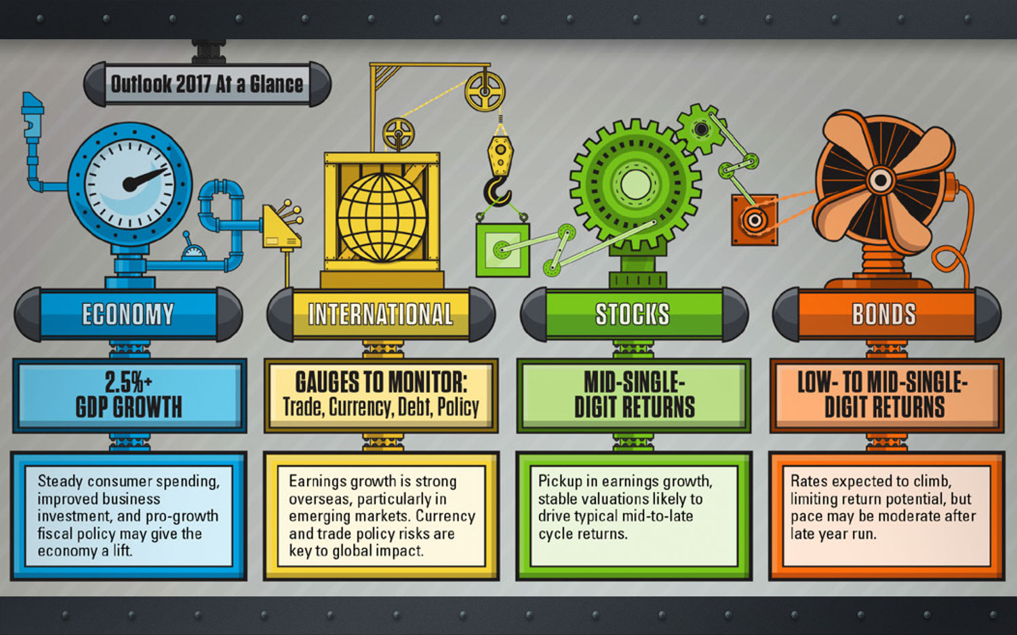
Please refer to the Appendix for a full explanation of our forecasts.

Slide 6
Economy
Approaching Mid-Cycle Acceleration
We expect 2.5%+ GDP growth in 2017
We expect 2, possibly 3 Fed rate hikes in 2017
We expect continued acceleration in Inflation
Economy may get a lift from:
Steady consumer spending
Improved business investment
Pro-growth fiscal policy
Gross Domestic Product (GDP) is the monetary value of all the finished goods and services produced within a country's borders in a specific time period, though GDP is usually calculated on an annual basis. It includes all of private and public consumption, government outlays, investments and exports less imports that occur within a defined territory.
Notes:
U.S. Economy: 2.5% GDP We expect GDP growth to accelerate modestly to near 2.5% with a low chance of a recession in 2017, driven by gains in consumer and business spending, supported by potential pro-growth fiscal policies.

Slide 7
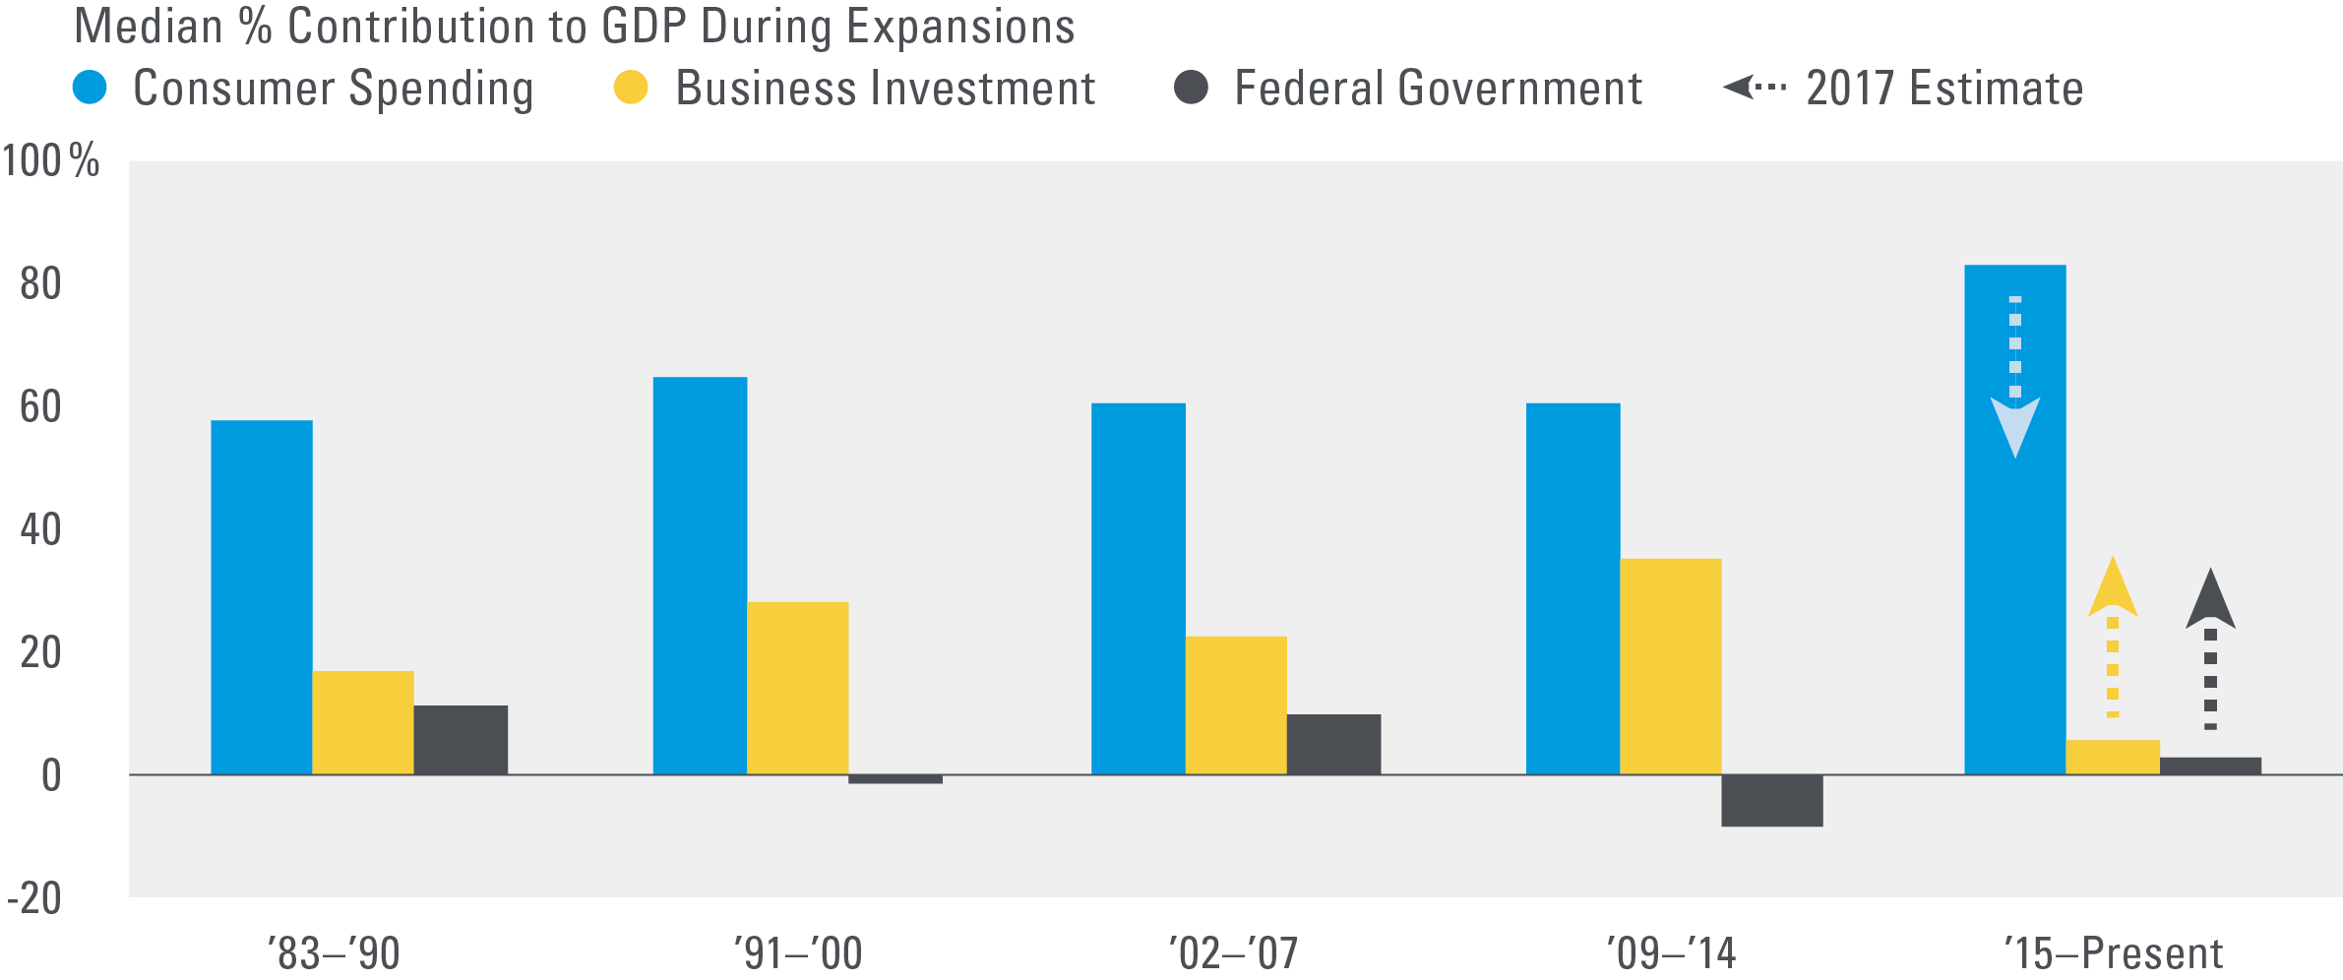
Economy
GDP Could Receive a Boost From a Better Mix of Growth Drivers
Source: LPL Research, Bureau of Economic Analysis 11/30/16
Chart does not include all economic sectors that make up GDP. Total GDP rescaled to reflect median contributions. 2009 – 2014 and 2015 to present are both part of the current expansion and are separated to highlight the recent economic environment.
Notes:
The boost in 2017 comes as the main drivers of growth shift from an emphasis on the consumer to a mix that includes manufacturing, capital expenditures, and government spending.

Slide 8
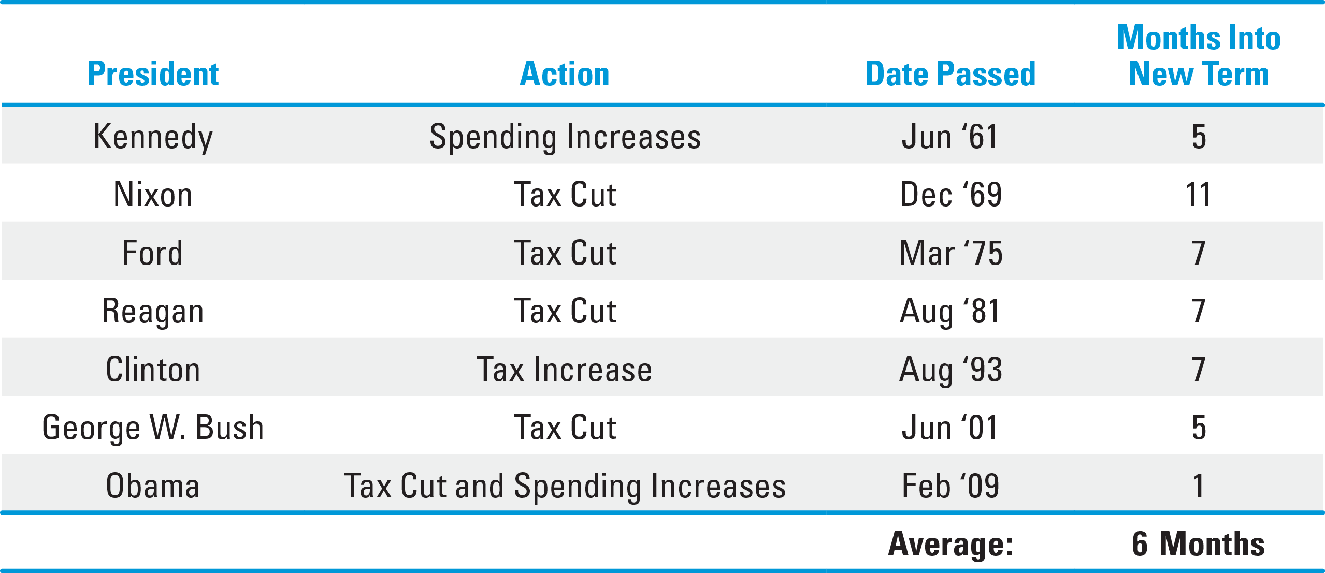
Economy
There’s Typically a Six-Month Delay from Taking Office to Fiscal Legislation
Source: LPL Research 11/30/16
Notes:
The timing of the passage of Trump’s proposals on taxes and infrastructure, as well as the speed of implementation, will be an important factor in their growth impact in 2017. We assume passage by mid-year 2017, but an earlier passage and start to implementation would pull more of the growth effect forward into 2017, while passage and implementation delays into late 2017 may push back the impact on growth, employment, and inflation until very late 2017 or early 2018.

Slide 9
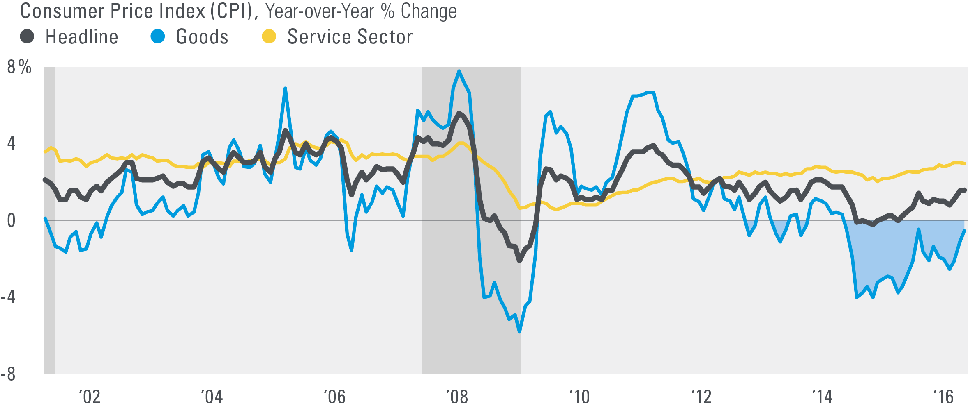
Economy
Commodities and Services Are Both Contributing to Higher Inflation
Source: LPL Research, Bureau of Labor Statistics, Haver Analytics 11/30/16
Shaded areas indicate recession.
The Consumer Price Index (CPI) is a measure of the average change over time in the prices paid by urban consumers for a market basket of consumer goods and services.
Commodity-linked investments may be more volatile and less liquid than the underlying instruments or measures, and their value may be affected by the performance of the overall commodities baskets as well as weather, geopolitical events, and regulatory developments.
Notes:
By the second half of 2016, in the U.S. at least, the factors pushing inflation higher may have begun to win the battle over disinflationary forces, marking an important transition for the economy.

Slide 10
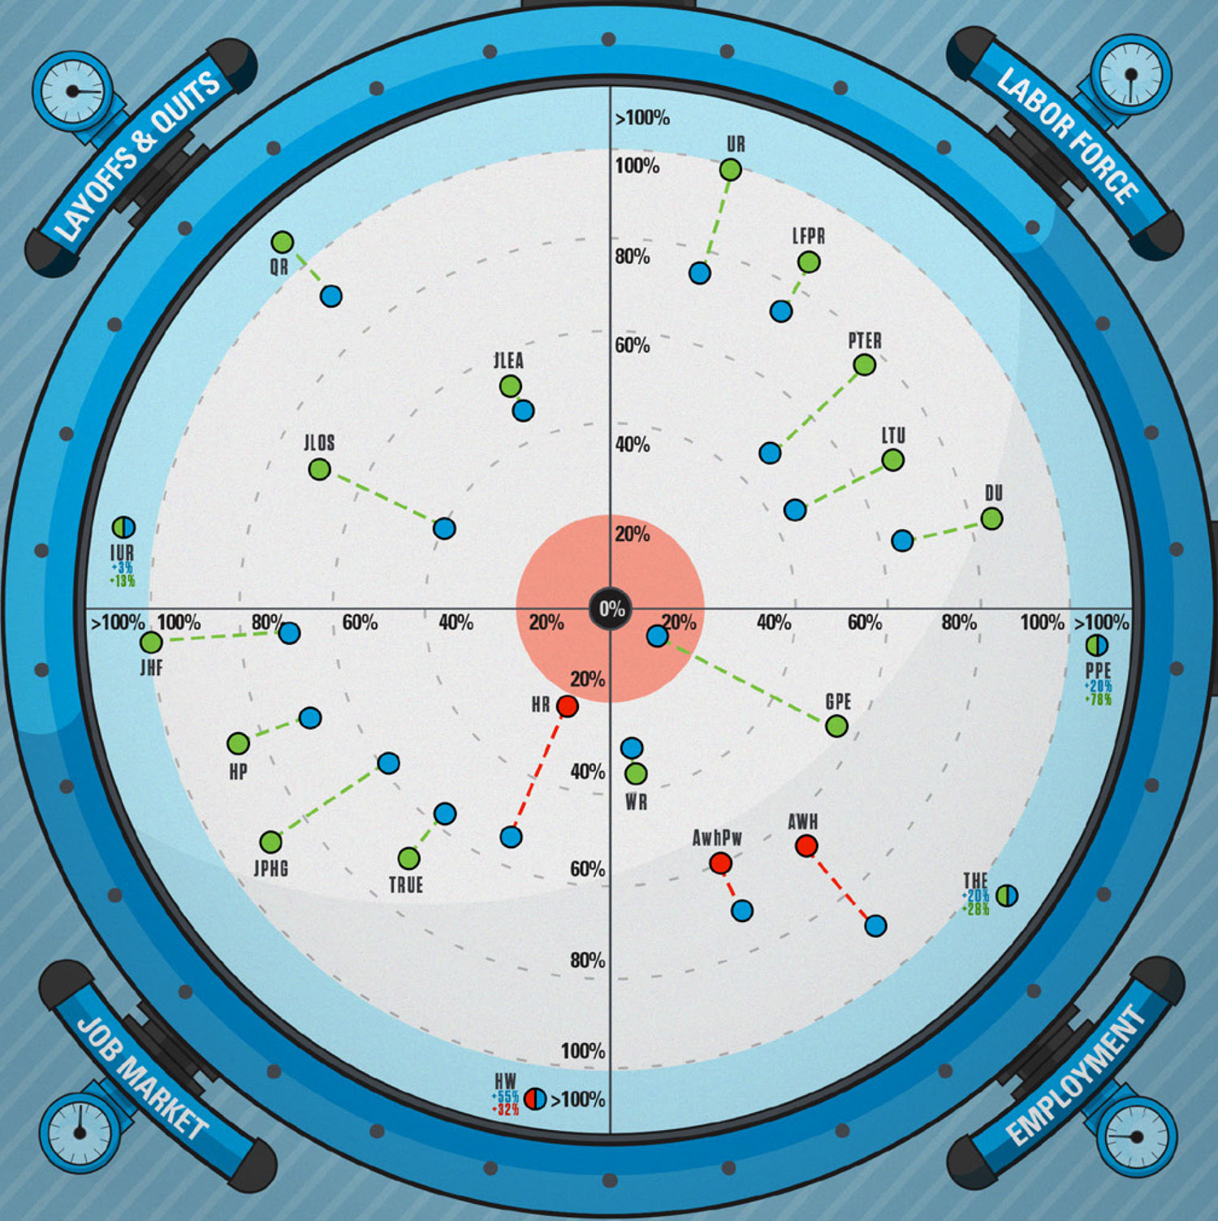
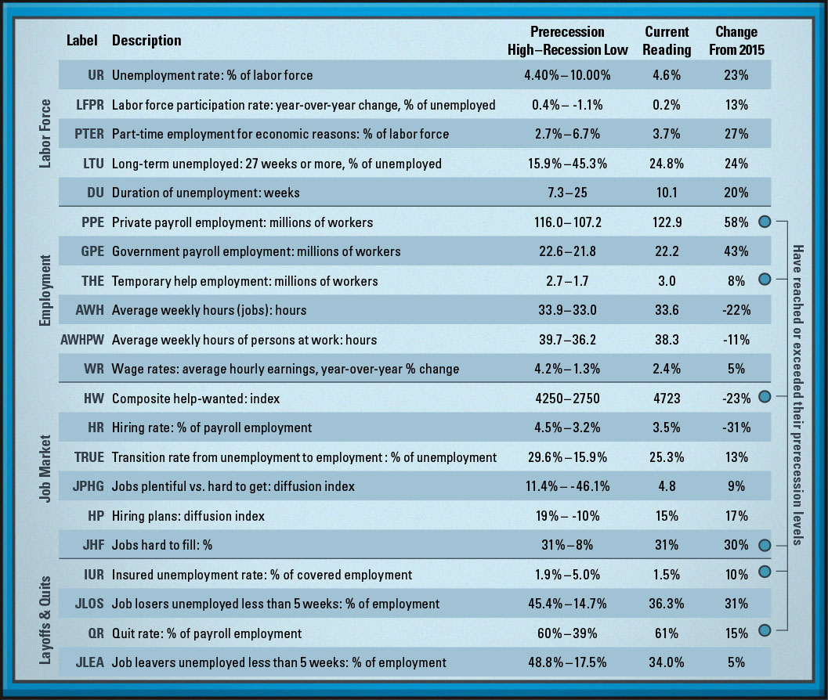
Economy
Labor Market Continues to Make Progress Toward Fed’s Goals
Source: LPL Financial Research, Bureau of Labor Statistics, Haver Analytics 11/30/16. The time frame for all data is the last 12 years: 2004–2016.

Slide 12
International
Global Balancing Act: Developed Foreign and Emerging Markets
Economic fundamentals have been improving across most regions
Earnings growth is strong overseas, particularly in emerging markets (EM)
Policy risks are key to global impact
Chinese debt will be a constant risk factor over the next few years
Currency is a crucial factor to performance relative to U.S. investments

Slide 13
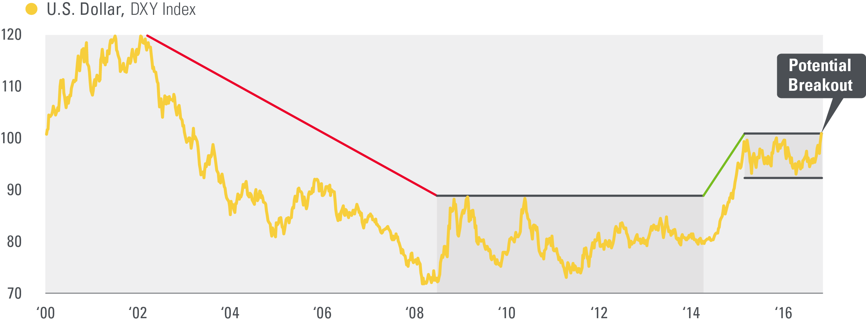
International
After a Multi-Year Downtrend, the U.S. Dollar Is Testing the Top of its Recent 18-Month Range
Source: LPL Research, Bloomberg 11/30/16
Currency risk is a form of risk that arises from the change in price of one currency against another. Whenever investors or companies have assets or business operations across national borders, they face currency risk if their positions are not hedged.
Notes:
Following the U.S. election, the dollar has rallied against almost all major currencies after moving in a broad trading range since the beginning of 2015.

Slide 15
STOCKS
Gears Are Turning, but Parts May Need Grease
Forecast mid-single-digit returns for S&P 500 for 2017
Pickup in earnings growth
Stable valuations
Both likely to drive typical mid-to-late cycle returns
Risks include a major policy mistake, etc.
Notes:
Stocks: Mid-Single-Digit Returns We expect mid-single-digit returns for the S&P 500 in 2017 consistent with historical mid-to-late economic cycle performance. We expect S&P 500 gains to be driven by: 1) a pickup in U.S. economic growth partially due to fiscal stimulus; 2) mid- to high-single-digit earnings gains as corporate America emerges from its year-long earnings recession; 3) an expansion in bank lending; and 4) a stable price-to-earnings ratio (PE) of 18–19.

Slide 16
STOCKS
Stock Market Gains Historically Tend to Accompany Mid-Cycle Economies
Source: LPL Research, FactSet 11/30/16
All indexes are unmanaged and cannot be invested into directly. Unmanaged index returns do not reflect fees, expenses, or sales charges. Index performance is not indicative of the performance of any investment. All performance referenced is historical and is no guarantee of future results.
*Indicates first year of each four-year presidential cycle.
^Please note: The modern design of the S&P 500 stock index was first launched in 1957. Performance back to 1950 incorporates the performance of predecessor index, the S&P 90.
Mid-cycle years (highlighted) are defined as more than a year away from the start or end of a recession.
Notes:
Our forecast for U.S. economic growth in 2017 supports our expectation for stock market gains next year and the continuation of the bull market past its eighth birthday. In years when the U.S. economy does not enter recession, the S&P 500 produces an average gain of 12% and is positive 84% of the time. These numbers are also consistent with the first year of the presidential cycle. In the first year of the four-year presidential cycle (as 2017 will be), when the U.S. economy does not enter into a recession, the S&P 500 gains an average of 9.3% and is higher 92% of the time (data back to 1950).*
*The modern design of the S&P 500 stock index was first launched in 1957. Performance back to 1950 incorporates the performance of predecessor index, the S&P 90.

Slide 17
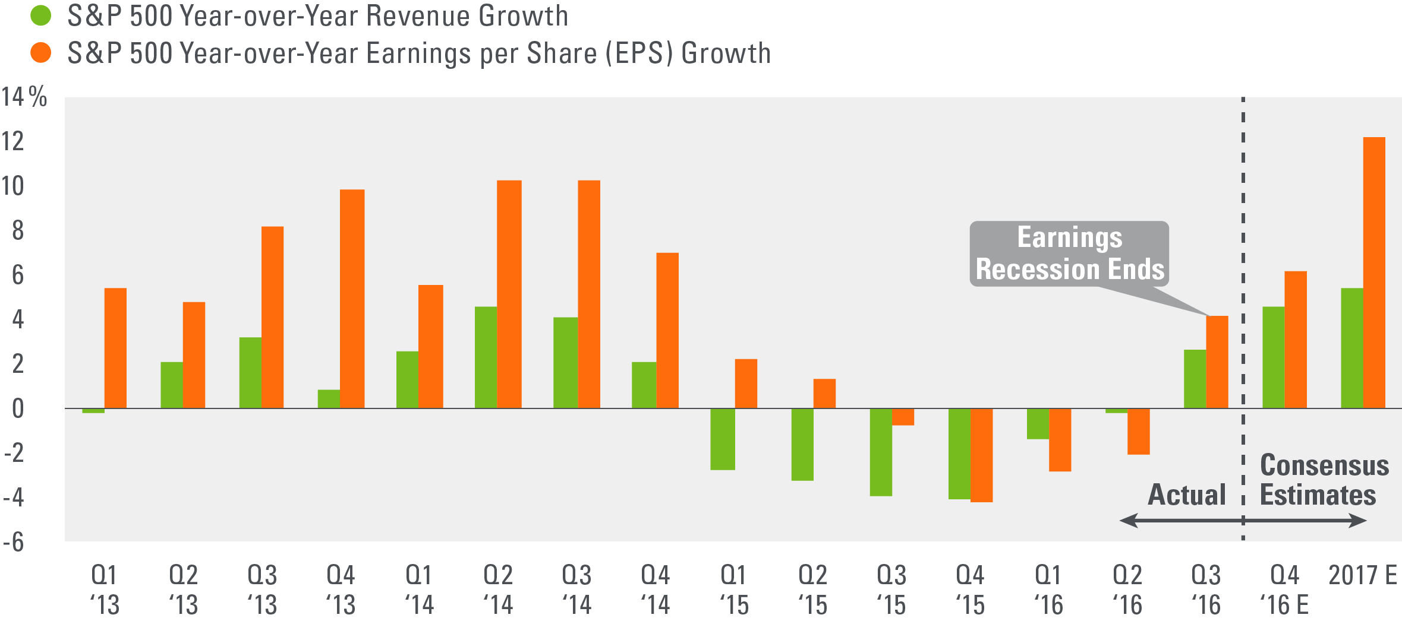
STOCKS
Earnings and Revenue Growth on the Upswing
Source: LPL Research, Thomson Reuters, FactSet 11/30/16
Earnings per share (EPS) is the portion of a company’s profit allocated to each outstanding share of common stock. EPS serves as an indicator of a company’s profitability. Earnings per share is generally considered to be the single most important variable in determining a share’s price. It is also a major component used to calculate the price-to-earnings valuation ratio.
Notes:
Label beginning and end of earnings recession
Earnings growth returned in late 2016 and may continue to gain momentum in the coming year. We expect earnings growth in the mid-to-high single digits in 2017, well above the flat earnings of 2016 and more consistent with long-term averages.

Slide 18
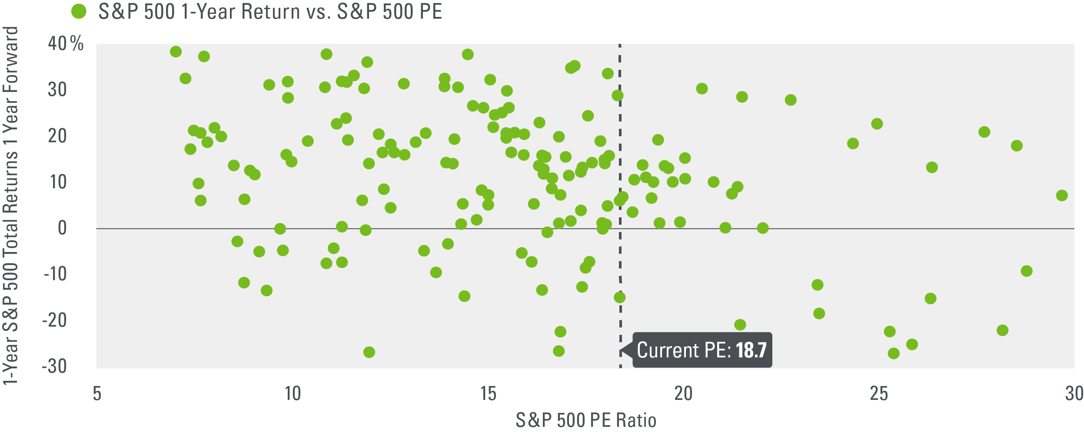
STOCKS
Little Relationship Between Stock Valuations and Short-Term Performance
Source: LPL Research, FactSet, Thomson Reuters 11/30/16
Data are from 1970 to the present.
The S&P 500 is an unmanaged index which cannot be invested into directly. Past performance is no guarantee of future results.
The PE ratio (price-to-earnings ratio) is a measure of the price paid for a share relative to the annual net income or profit earned by the firm per share. It is a financial ratio used for valuation: a higher PE ratio means that investors are paying more for each unit of net income, so the stock is more expensive compared to one with lower PE ratio.Earnings per share (EPS) is the portion of a company’s profit allocated to each outstanding share of common stock. EPS serves as an indicator of a company’s profitability. Earnings per share is generally considered to be the single most important variable in determining a share’s price. It is also a major component used to calculate the price-to-earnings valuation ratio.
Notes:
We don’t see high valuations as a reason to sell, as they have not been good indicators of stock market performance over the subsequent year, as shown here. (If the dots in this chart formed something resembling a straight line, it would be more indicative of a relationship.)

Slide 19
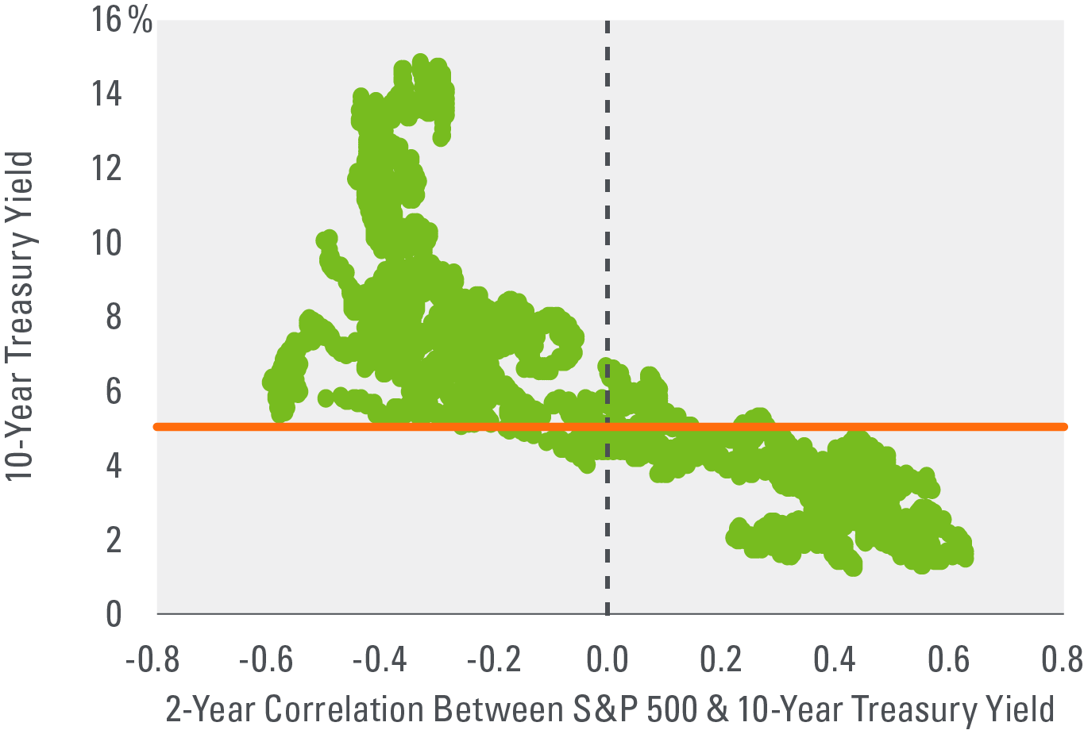
stocks
Stocks Not Hurt as Much by Higher Interest Rates When Rates Are Low
Source: Bloomberg, FactSet 11/30/16
Data since 1968.
Correlation ranges between -1 and +1. Perfect positive correlation (a correlation co-efficient of +1) implies that as one security moves, either up or down, the other security will move in lockstep, in the same direction. Alternatively, perfect negative correlation means that if one security moves in either direction the security that is perfectly negatively correlated will move in the opposite direction. If the correlation is 0, the movements of the securities are said to have no correlation; they are completely random.
Notes:
Historically, when the 10-year Treasury yield has been below 5%, stock market returns and interest rates have tended to rise and fall together (positive correlation).

Slide 20
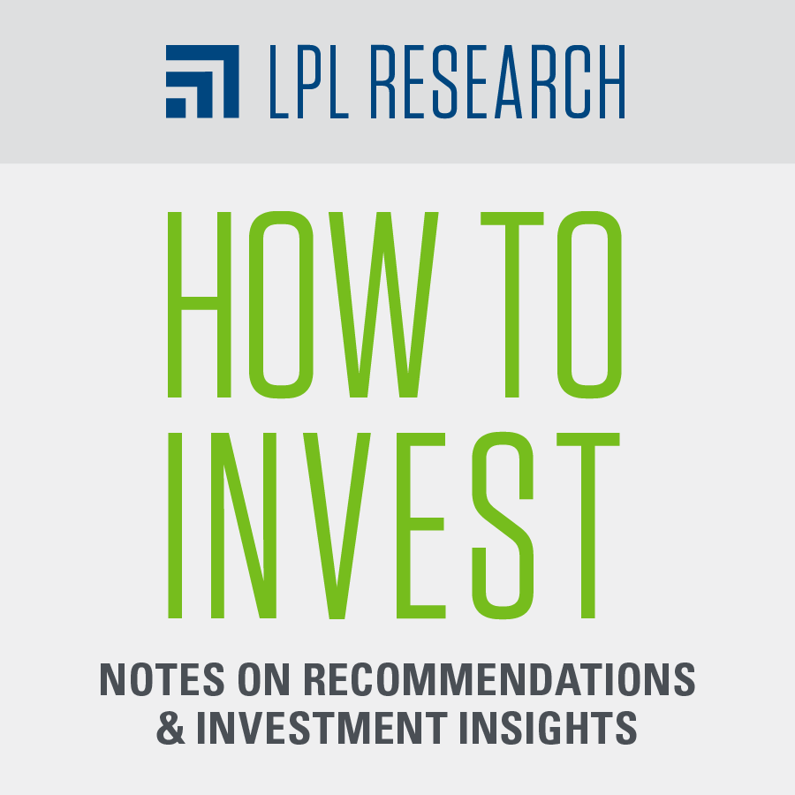
Stocks
How to Invest
Balanced performance between growth and value style
Policy tailwind may benefit small caps in 1H 2017, large may reassert in 2H 2017
Favor cyclical sectors for improving economic growth
Concentrate in U.S. while watching EM for opportunities

Slide 22
BONDS
Despite Liftoffs, Expect Muted Bond Returns
Modest rising rate backdrop likely to lead to low- to mid-single-digit bond returns
Rates expected to climb, limiting return potential
Pace may moderate after late-2016 run-up in Treasury yields
Notes:
Bonds: Low- to Mid-Single-Digit Returns We expect the 10-year Treasury yield to end 2017 in its current range of 2.25-2.75%, with a potential for 3.0%. Scenario analysis based on this potential interest rate range and the duration of the index indicates low-to-mid single digit returns for the Barclays Aggregate Bond Index.

Slide 23
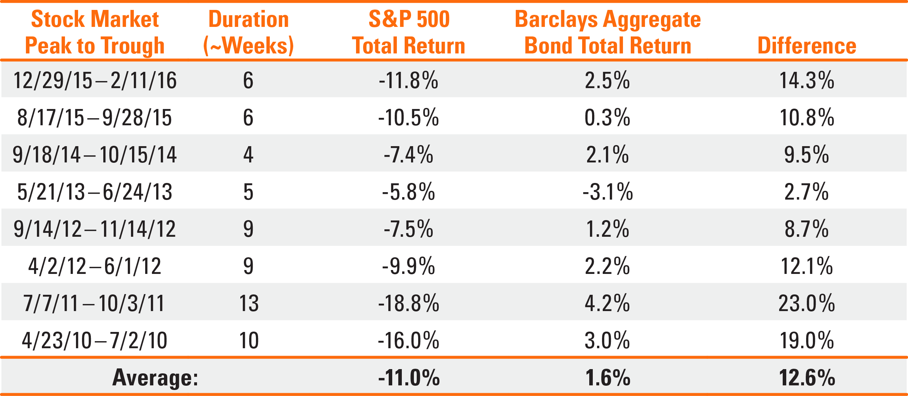
BONDS
Bond Performance Relative to Equities Shows Diversifying Role of High-Quality Fixed Income
Source: LPL Research, Bloomberg, Standard & Poor’s, Barclays 11/30/16
All performance referenced is historical and is no guarantee of future results.
Notes:
During equity market pullbacks since 2010, the S&P 500 averaged a -11% total return, while the broad bond market returned 1.6%, on average.

Slide 24
BONDS
Broad Bond Market Returns May be Muted in 2017
Source: LPL Research, Barclays 11/30/16
Scenario analysis is based on a return of 3.1% as of 11/11/16 for the Barclays Aggregate, based upon one-year time horizon, parallel shifts in the yield curve, no change to yield spreads, and no reinvestment of interest income.
This is a hypothetical example and is not representative of any specific situation. Your results will vary. The hypothetical rates of return used do not reflect the deduction of fees and charges inherent to investing.
Indexes are unmanaged and cannot be invested into directly.
Notes:
Scenario analysis for the broad bond market in 2017 shows the influence that interest rates can have on high-quality fixed income returns.

Slide 25
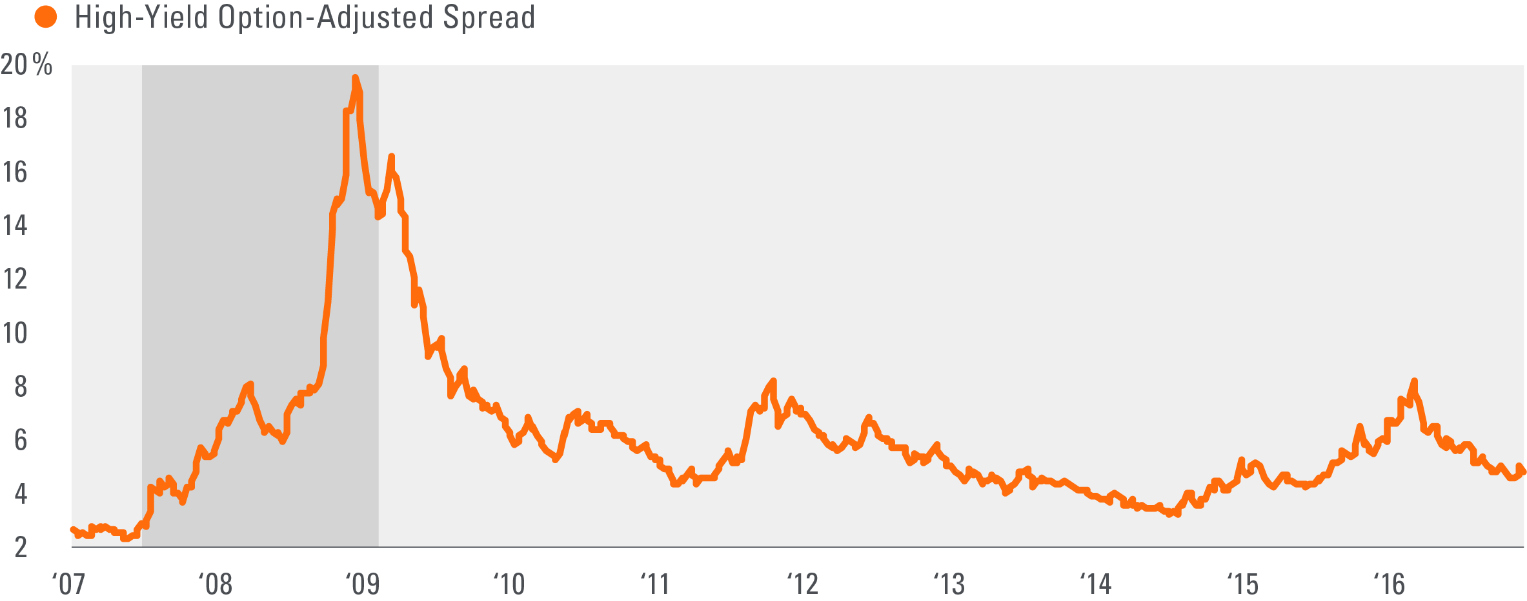
BONDS
High-Yield Spreads Tightened Throughout Most of 2016
Source: LPL Research, Bloomberg 11/30/16
Shaded area indicates recession.
High-Yield spread is the yield differential between the average yield of high-yield bonds and the average yield of comparable maturity Treasury bonds.
Notes:
With oil oscillating in the $40-50 range throughout the majority of 2016, high-yield valuations increased throughout the latter half of the year as default prospects slowly improved. Despite this improvement, the price of oil remains a powerful force in the high-yield market and an ongoing risk.
We have seen a dramatic rally in credit in 2016, but we don’t expect the same performance for 2017. [Colin]

Slide 26
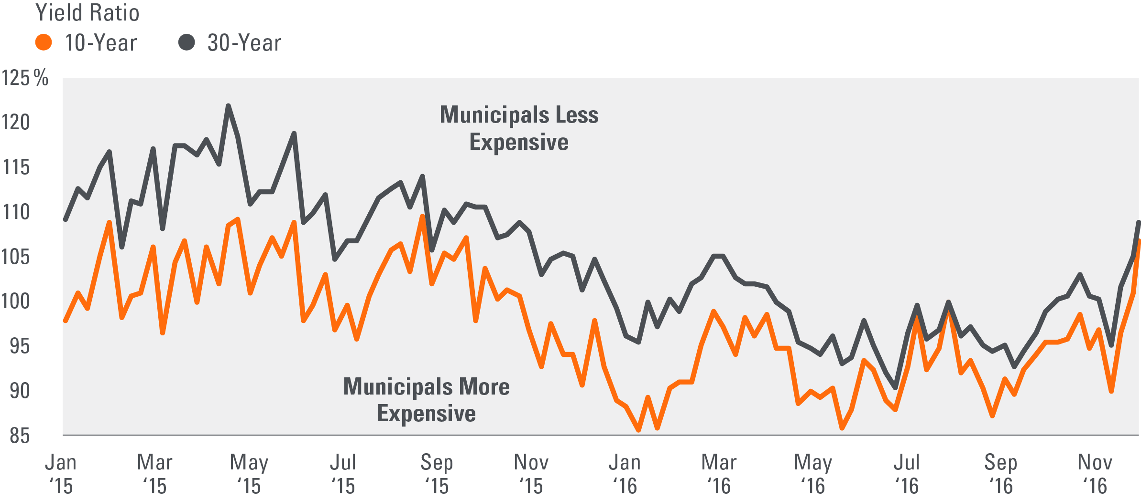
BONDS
Municipal-to-Treasury Yield Ratios Indicate a Relatively Pricey Muni Market to Start 2017
Source: LPL Research, Bloomberg 11/10/16
Notes:
Post-election, as fixed income markets digested the economic implications of a Trump presidency, yields in the tax-sensitive municipal market began to spike, though not as much as Treasury yields, making relative valuations more expensive.

Slide 27
Bonds
How to Invest
Intermediate-term bonds
Moderate credit sensitivity

Slide 29
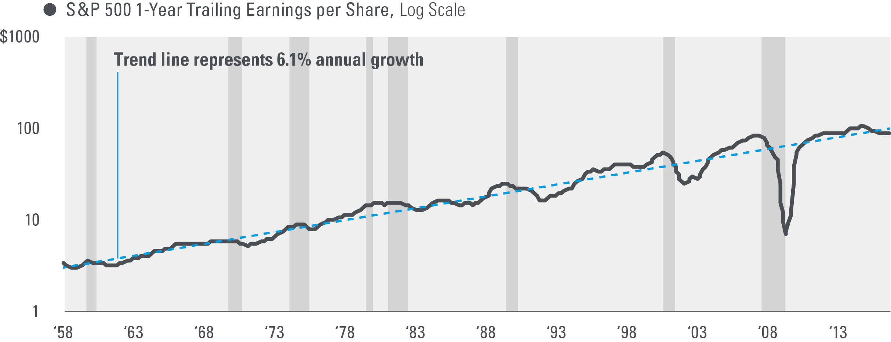
The Strategic View
Long-Term Trend of Earnings Growth Has Been Steady
Source: LPL Research, Standard and Poor’s, Robert Shiller 11/30/16
Shaded areas indicate recession.

Slide 30
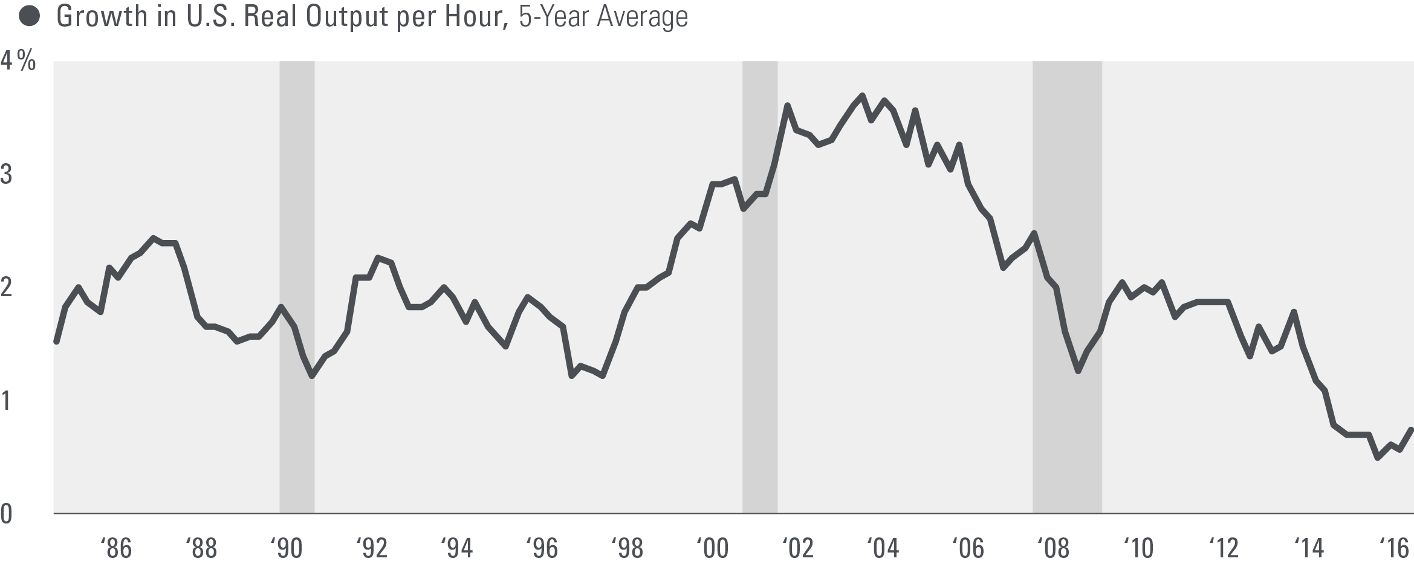
The Strategic View
Productivity Rebound Essential for a Better Growth Trajectory
Source: U.S. Bureau of Labor Statistics 11/30/16
Shaded areas indicate recession.

Slide 31
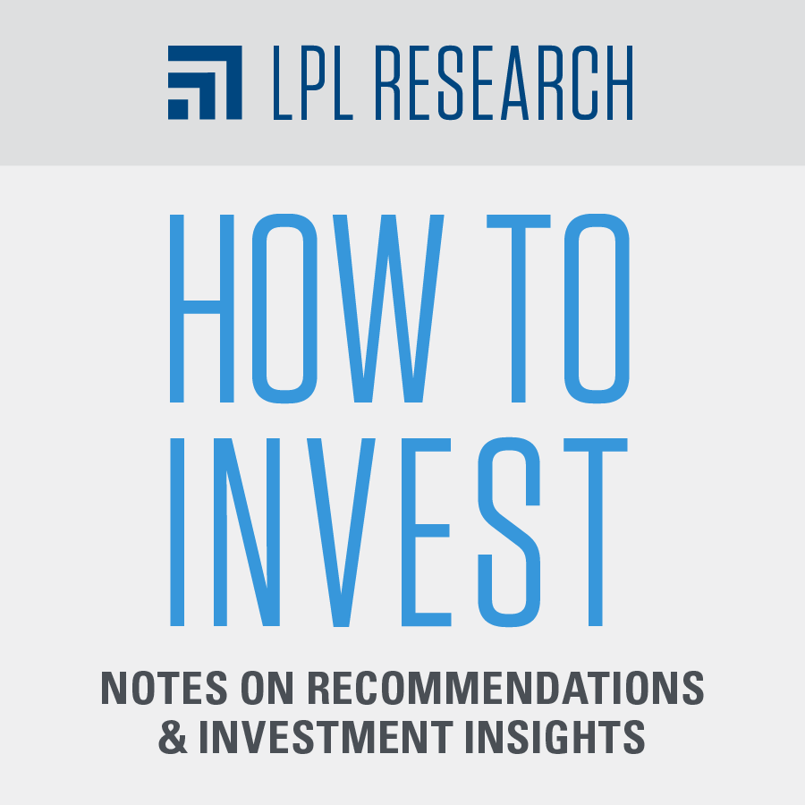
Conclusion
How to Invest
Stocks
Balanced performance between growth and value style
Policy tailwind may benefit small caps in 1H 2017, large may reassert in 2H 2017
Favor cyclical sectors for improving economic growth
Concentrate in U.S. while watching EM for opportunities
Bonds
Intermediate-term bonds
Moderate credit sensitivity

Slide 32
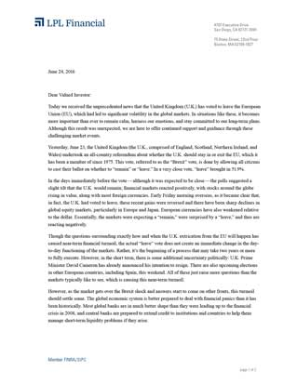
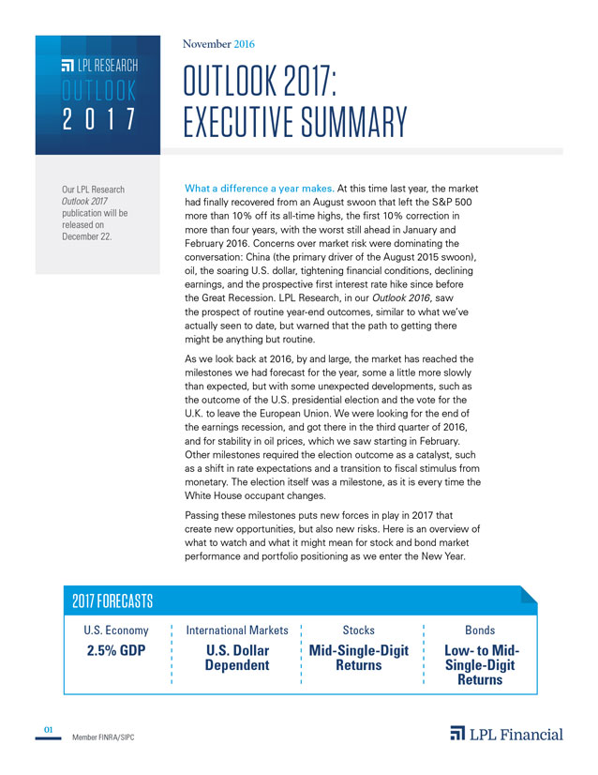
REsources
Outlook 2017 Collateral
Hard Copy & PDF versions
PowerPoint Presentation
Client Letter
Executive Summary
Video
How to Invest Guide
Do-It-Yourself Advisor Suite
Institutional White Paper
Institutional PPT

Slide 33
Important Disclosures
The opinions voiced in this material are for general information only and are not intended to provide or be construed as providing specific investment advice or recommendations for any individual security. To determine which investments may be appropriate for you, consult your financial advisor prior to investing. All performance referenced is historical and is no guarantee of future results. All indexes are unmanaged and cannot be invested into directly.
Economic forecasts set forth may not develop as predicted, and there can be no guarantee that strategies promoted will be successful.
Stock and Pooled Investment Risks Investing in stock includes numerous specific risks including: the fluctuation of dividend, loss of principal and potential illiquidity of the investment in a falling market.
Indices are unmanaged index and cannot be invested into directly. Unmanaged index returns do not reflect fees, expenses, or sales charges. Index performance is not indicative of the performance of any investment. Past performance is no guarantee of future results.
Because of their narrow focus, specialty sector investing, such as healthcare, financials, or energy, will be subject to greater volatility than investing more broadly across many sectors and companies.
There is no guarantee that a diversified portfolio will enhance overall returns or outperform a non-diversified portfolio. Diversification does not ensure against market risk.
Investing in foreign and emerging markets securities involves special additional risks. These risks include, but are not limited to, currency risk, geopolitical risk, and risk associated with varying accounting standards. Investing in emerging markets may accentuate these risks.
Bond and Debt Equity Risks Bonds are subject to market and interest rate risk if sold prior to maturity. Bond and bond mutual fund values and yields will decline as interest rates rise and bonds are subject to availability and change in price.
Government bonds and Treasury bills are guaranteed by the U.S. government as to the timely payment of principal and interest and, if held to maturity, offer a fixed rate of return and fixed principal value. However, the value of fund shares is not guaranteed and will fluctuate.
High-yield/junk bonds are not investment-grade securities, involve substantial risks, and generally should be part of the diversified portfolio of sophisticated investors.
Municipal bonds are subject to availability, price, and to market and interest rate risk if sold prior to maturity. Bond values will decline as interest rate rise. Interest income may be subject to the alternative minimum tax. Federally tax-free but other state and local taxes may apply.
Bank loans are loans issued by below investment-grade companies for short-term funding purposes with higher yield than short-term debt and involve risk.

Slide 34
Important Disclosures
The S&P 500 Index is a capitalization-weighted index of 500 stocks designed to measure performance of the broad domestic economy through changes in the aggregate market value of 500 stocks representing all major industries.
The Barclays U.S. Aggregate Bond Index is a broad-based flagship benchmark that measures the investment-grade, U.S. dollar-denominated, fixed-rate taxable bond market. The index includes Treasuries, government-related and corporate securities, MBS (agency fixed-rate and hybrid ARM pass-throughs), ABS, and CMBS (agency and non-agency).
The U.S. Dollar Index (DXY) indicates the general international value of the U.S. dollar. The DXY Index does this by averaging the exchange rates between the US dollar and six major world currencies.
Not FDIC or NCUA/NCUSIF Insured | No Bank or Credit Union Guarantee | May Lose Value | Not Guaranteed by Any Government Agency | Not a Bank/Credit Union Deposit
Tracking # 1-565302 Exp. 12/17

Slide 35
THANK YOU FOR YOUR BUSINESS
This research material has been prepared by LPL Financial LLC.
Securities offered through LPL Financial LLC.

Slide 36
Appendix

Slide 37
Outlook 2017: Forecasts
U.S. Economy: 2.5% GDP We expect GDP growth to accelerate modestly to near 2.5% with a low chance of a recession in 2017, driven by gains in consumer and business spending, supported by potential pro-growth fiscal policies.
Stocks: Mid-Single-Digit Returns We expect mid-single-digit returns for the S&P 500 in 2017 consistent with historical mid-to-late economic cycle performance. We expect S&P 500 gains to be driven by: 1) a pickup in U.S. economic growth partially due to fiscal stimulus; 2) mid- to high-single-digit earnings gains as corporate America emerges from its year-long earnings recession; 3) an expansion in bank lending; and 4) a stable price-to-earnings ratio (PE) of 18–19.
Bonds: Low- to Mid-Single-Digit Returns We expect the 10-year Treasury yield to end 2017 in its current range of 2.25–2.75%, with a potential for 3.0%. Scenario analysis based on this potential interest rate range and the duration of the index indicates low-to-mid single digit returns for the Barclays Aggregate Bond Index.

